Slide 1
/01
Prism's Performance Unveiled: Insights, Trends, and Strategic Recommendations
PRESENTED BY THE PRISM DATA LAB
Harini, Shravya, Mar
Notes:
Hi everyone, we’re Prism Data Lab, and we’re going to present our project and dashboard to you

Slide 2


/02
C
D
F
R
Context
Data
Findings
Recommendations & Impact
Critical insights about our strengths and areas of improvement.
What’s our current situation?
Identifying patterns, trends, and business KPIs requiring attention.
PRISM DATA LAB
Actionable recommendations that provide a roadmap for impact.
Notes:
So Today we'll discuss the context to this project, then look at the data and trends we found, and the findings we can draw from each KPI, and then specific recommendations to improve.

Slide 3

/03
What’s our situation?
We lack a central platform for real-time business insights.
We have difficulty in tracking key KPI metrics & identifying trends consistently across departments.
Quadrangle’s Vision:
Transform Prism into a data-driven organisation.
Enable strategic decisions, efficiency, and business scalability by taking action on recommendations.
Notes:
Prism currently lacks a central dashboard to monitor business health and track KPIs, which makes critical decisions challenging. As part of Quadrangle, aligning with their data-driven goal is really important. The dashboard we've created will aid in the efficiency and support of Prism’s business growth.

Slide 4
/04
The KPIs:
Profit Margin: The % of revenue remaining after accounting for COGS.
Refund Rate: The % of transactions that result in a refund.
ROAS: The revenue generated for each £ spent on advertising.
Retention Rate: The % of customers who return to engage in subsequent months.
Conversion Rate: The % of visitors who make a purchase after viewing an item.
Notes:
So here are our KPIS and how we calculated them
These KPIs provide a snapshot of Prism's health: Profit Margin shows efficiency of operations, while Refund Rate shows product quality and customer satisfaction. ROAS shows the value of our marketing investments, Retention Rate tracks our customer loyalty, and Conversion Rate show how well visitors are turned into buyers.
All of them reflect profitability, customer behaviour, and marketing impact, making them Prism’s top KPIs.

Slide 5
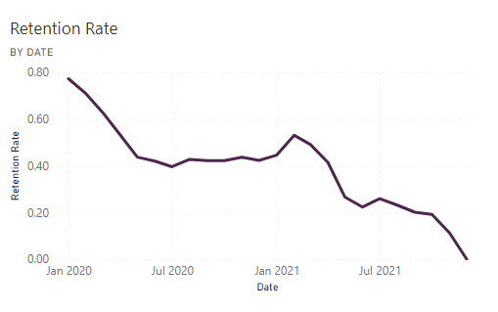
/05
Customer Metrics: Retention Rate
Customer retention rate tells us the percentage of customers who have interacted with Prism.
The overall pattern shows a decrease in engagement from 2020-2021.
However, the retention decreases from and peaks again during December to February. The winter season is Prism’s optimal time of the year.
Recommendable Action: focus on improving advertisements and promotion outside of the winter season, i.e. spring, summer, to attract new customers.
Offer promotions and personalised bounce-back offers during the June/July.

Slide 6
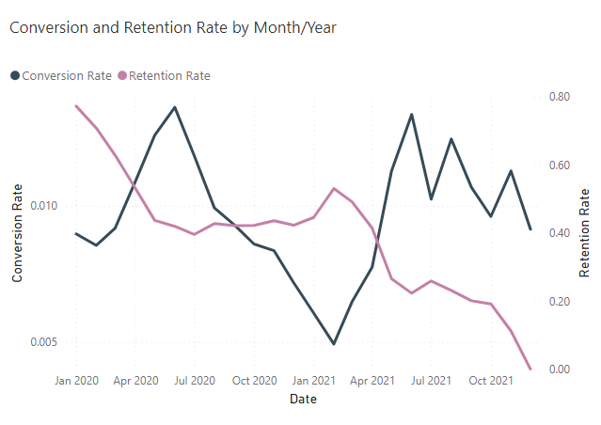
/06
Customer Metrics: Conversion Rate
The conversion rate, however, runs in contrast with the retention rate. In winter, although our existing customers are more engaged, they’re not in favour of completing purchases.
Seasonal demand drives conversions in summer.
Winter retention reflects our core customer base.
Recommendable Action: bridge the gap and align winter/summer strategies.
Investigate difference in customer behaviour and the ‘why?’ with post-purchase surveys.
Implement loyalty programs to encourage repeat business.
Notes:
use customers past behavior to sell personalised deals.
Use NPS metric (Net Promoter Score) to gather qualitative feedback.

Slide 7
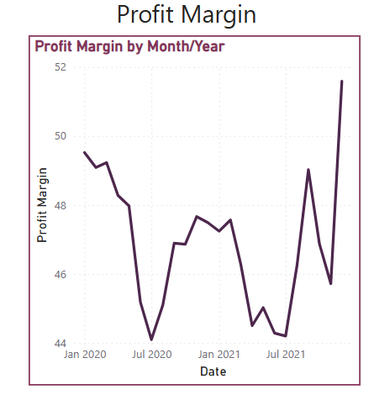
/07
Business Metrics: Profit Margin
This shows that there are notable Fluctuations in the profit margin from Jan 2020 to 2021.
Mid 2020: Sharp decline below 46%, likely due to operational costs, or shifts in pricing strategies?
End 2021: Recovering to over 52%, indicating improved cost management or pricing stratergies
Notes:
The profit margin graph shows considerable fluctuations over the two-year period. In mid-2020, there’s a steep decline, with margins dropping below 46%. This could be attributed to increased operational costs, such as supply chain disruptions or higher production expenses, and this could impact profit margins by increasing the cost of goods sold. So if there was higher shipping costit could have raised operational cost, directly lowering the profit margin. As the graph moves toward the end of 2021, we see a sharp recovery, peaking above 52%. This improvement could be tied to factors such as reduced operational costs and optimised pricing strategies. These fluctuations reflect the dynamic nature of the business environment during that period

Slide 8
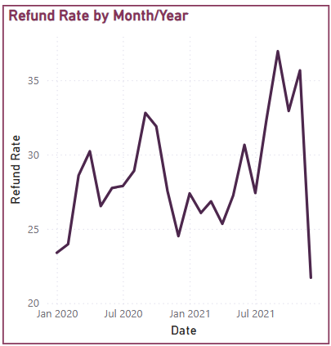
/08
Business Metrics: Refund Rate
Fluctuations observed in refund rates between Jan 2020 and 2021.
Mid-2021: Peak above 35%, signaling potential product or service issues.
End-2021: Sharp decline below 20%, suggesting improved processes.
High refund rates could be linked to product quality, unmet customer expectation, or delivery/logistical issues?
Notes:
The refund rate data shows considerable variation between January 2020 and 2021. Mid-2021 sees a peak above 35%, likely pointing to an increase in returns. This could have been driven by issues such as not meeting customer expectations where a customer might return an item if its size, colour or features do not aligns with the advertised details, and unreliable courier service where a package may have not arrived in time for an event may prompt a customer to return an item. However, by the end of 2021, there is a sharp decline, with refund rates dropping below 20%. This suggests that some corrective measures, such as improvements in operational processes or addressing customer concerns were successfully implemented. These trends highlight the importance of closely monitoring refund rates to ensure customer satisfaction and maintain business profitability.

Slide 9
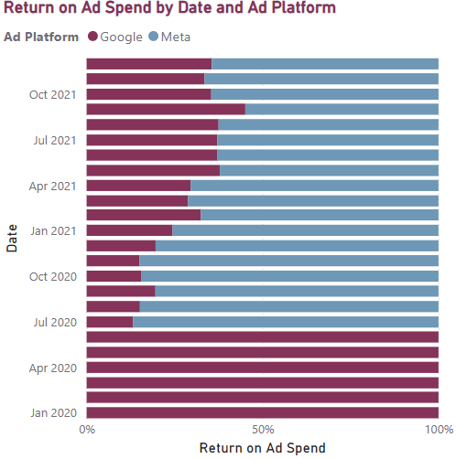
/09
Business Metrics: ROAS
Meta outperforms Google in ROAS for most periods from July 2020 onward.
Google achieves 100% ROAS from January to July 2020, fully recovering its ad spend during this period.
Fluctuations observed in ROAS across both platforms, with closer competition in some months (e.g., April 2021).
Key Insight: Meta consistently delivers stronger returns after July 2020. Investing in Meta is more cost-efficient!
Notes:
The chart shows that Meta, represented by the blue bars, consistently outperforms Google in ROAS from July 2020 onward, likely due to advanced targeting algorithms maximizing engagement and conversions. Google, represented by the brown bars, achieves a strong 100% ROAS from January to July 2020 but declines significantly after, possibly due to increased competition and higher costs. In some months, like April 2021, the gap narrows, likely due to seasonal trends, with customers using Google for sales-related searches like discounts or product comparisons. Overall, Meta proved more reliable for higher ROAS after mid-2020.

Slide 10


/10
Specific Recommendations
Invest in ads and promotions in low profit margin months.
Send out post-purchase surveys in the months with high refunds to understand root cause.
Reallocate at least 20% of the current Google budget to Meta to capitalise on the better-performing platform.
Develop a subscription-based loyalty program and bounce-back offers to incentivise long-term engagement and retention.
Introduce guest checkout to optimise the checkout experience so there higher conversions to ‘purchase’.
PRISM DATA LAB
Notes:
Based on the data insights, we recommend to:
- Release new collections in low-profit months.
- Send post-purchase surveys to identify refund causes.
- Reallocate 20% of Google's budget to Meta.
- Develop a subscription loyalty program and bounce-back offers.
- Introduce guest checkout to boost conversions.

Slide 11
/11
Impact
Boosting revenue leads to smoother profit margin trends which would improve profitability.
Reducing refund rates by understanding the cause directly increases revenue, customer loyalty and satisfaction.
Reallocating ad budget ensures efficient ad spending, improving marketing ROI.
Loyalty programs increase CLV by creating a steady revenue stream.
A guest checkout option would reduce cart abandonment rates, leading to higher conversion rates.
PRISM DATA LAB
Notes:
The impact here would be that these recommendations would help stabilise profit margins, reduce the amount of refund, and improve customer loyalty. Reallocating ad spend ensures efficient spending, while loyalty programs increase customer lifetime value and gives Prism a steady revenue stream. Offering guest checkout reduces our cart abandonment issue.

Slide 12
/12
Link to KPI DOCUMENTATION
Thank You!
Harini, Shravya, Mar
PRISM DATA LAB
20th November 2024

